Slide 1


DOCKER ASSIGNMENT
Presented By :
MAYURI DHOTE

Slide 2
AGENDA:
Introduction related to Tools & Technologies.
Create a Jenkins pipeline to deploy application present at: https://github.com/knoldus/node-hello
Use any type of Jenkins project.
Required command to run the application and the ports being used are present in the Github repository.
The application should be containerized and should be running on docker.
The image has to be pushed on Docker Hub and should be pulled for running.
The ports of the application should be open for communication and accept connection on the host machine.
Implement use of Global Tools Configuration to use Node JS effectively
The validations can be performed by hitting endpoints: <VM_IP>:3000 or <VM_IP>:3001
Notes:
<number>

Slide 3
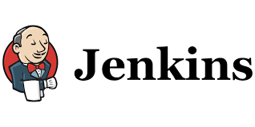

Introduction Tools & Technologies: AWS and JENKINS
Amazon Web Services
Amazon Web Services Inc. (AWS) is a subsidiary of Amazon providing on-demand cloud computing platforms and APIs to individuals, companies, and governments, on a metered pay-as-you-go basis. These cloud computing web services provide a variety of basic abstract technical infrastructure and distributed computing building blocks and tools.
One of these services is Amazon Elastic Compute Cloud (EC2), which allows users to have at their disposal a virtual cluster of computers, available all the time, through the Internet. AWS's virtual computers emulate most of the attributes of a real computer, including hardware central processing units (CPUs) and graphics processing units (GPUs) for processing; local/RAM memory; hard-disk/SSD storage; a choice of operating systems; networking; and pre-loaded application software such as web servers, databases, and customer relationship management (CRM).
Jenkins
Jenkins is a free and open source automation server. It helps automate the parts of software development related to building, testing, and deploying, facilitating continuous integration and continuous delivery. It is a server-based system that runs in servlet containers such as Apache Tomcat. It supports version control tools, including AccuRev, CVS, Subversion, Git, Mercurial, Perforce, ClearCase and RTC, and can execute Apache Ant, Apache Maven and sbt based projects as well as arbitrary shell and Windows batch commands
Notes:
<number>

Slide 4
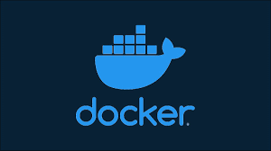
DOCKER
Docker is a set of platform as a service (PaaS) products that use OS-level virtualization to deliver software in packages called containers.[6] Containers are isolated from one another and bundle their own software, libraries and configuration files; they can communicate with each other through well-defined channels.[7] Because all of the containers share the services of a single operating system kernel, they use fewer resources than virtual machines.[8]
The service has both free and premium tiers. The software that hosts the containers is called Docker Engine.[8] It was first started in 2013 and is developed by Docker, Inc.

Slide 5
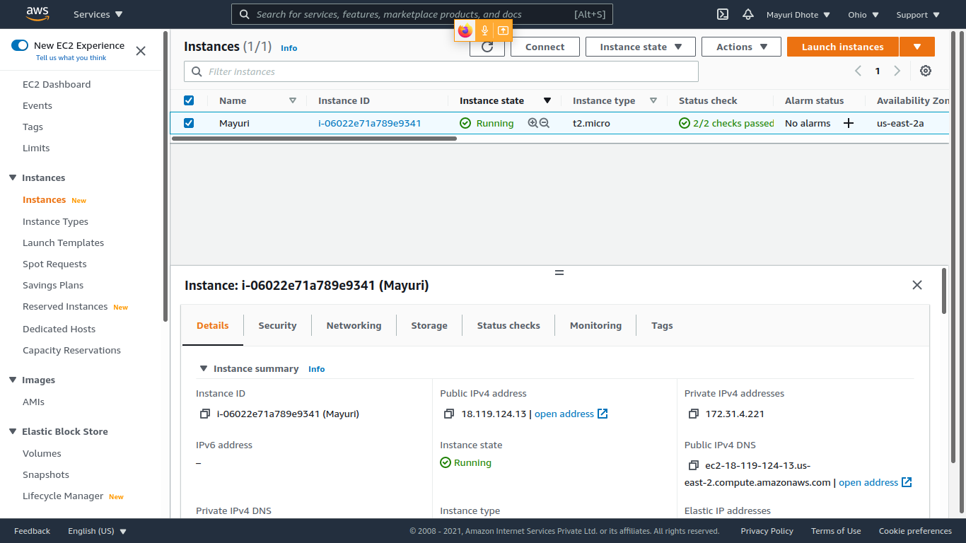
Create a Jenkins pipeline to deploy application present at: https://github.com/knoldus/node-hello and use any type of Jenkins project. Creating an Instance at AWS Account

Slide 6
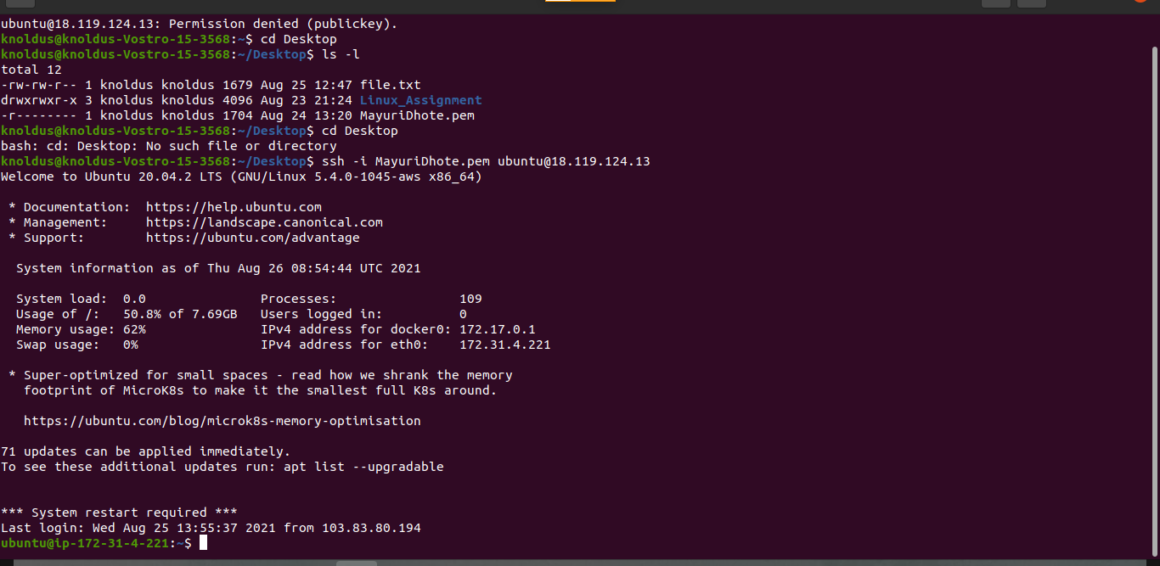
Create a Jenkins pipeline to deploy application present at: https://github.com/knoldus/node-hello and use any type of Jenkins project. Accessing VM from the System

Slide 7
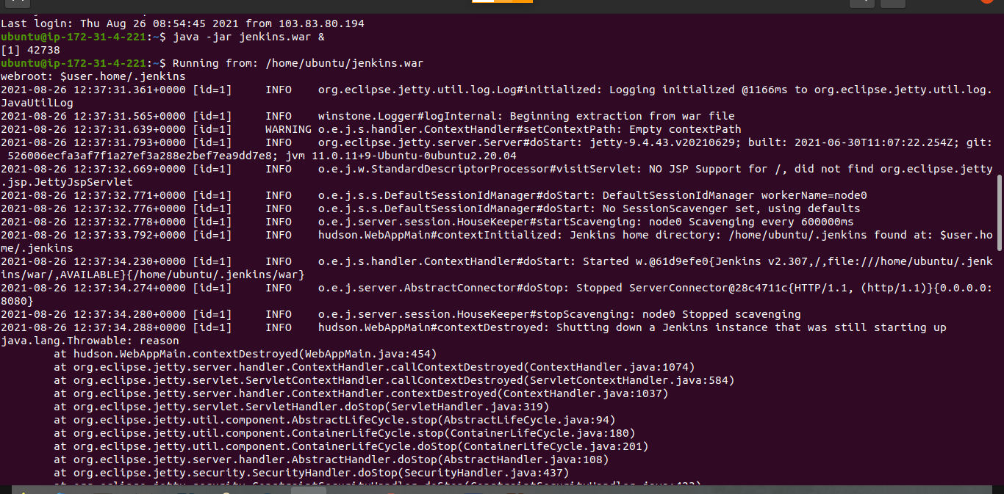
Create a Jenkins pipeline to deploy application present at: https://github.com/knoldus/node-hello and use any type of Jenkins project. Running Jenkins in the Terminal

Slide 8
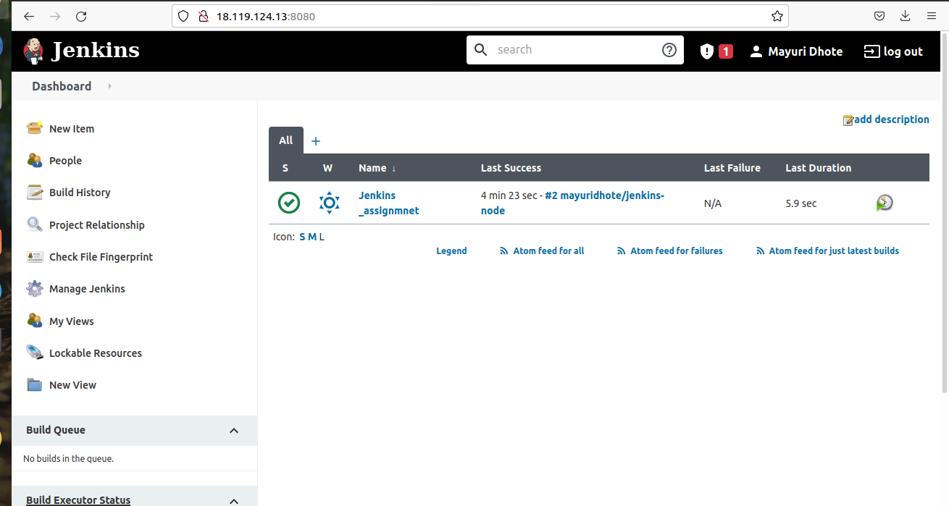
Create a Jenkins pipeline to deploy application present at: https://github.com/knoldus/node-hello and use any type of Jenkins project. Running Jenkins in the Terminal

Slide 9
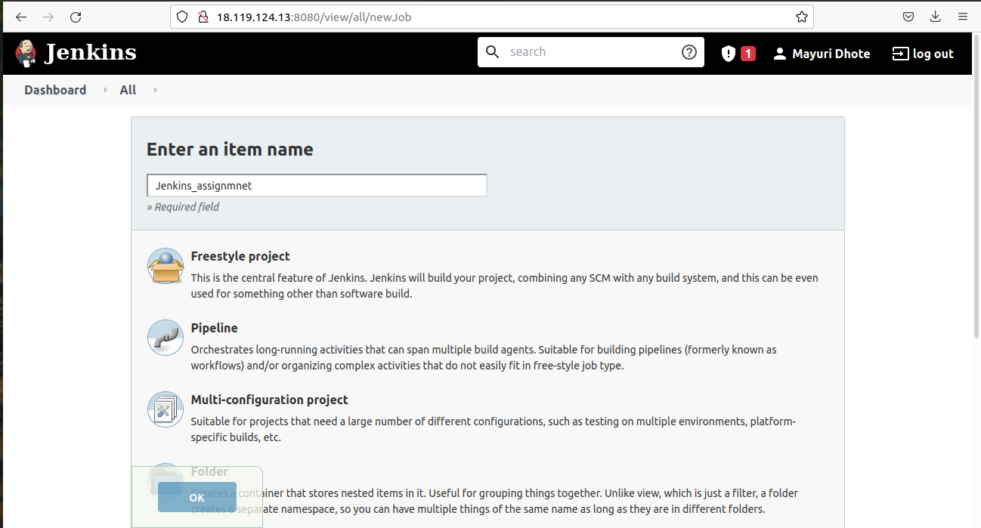
Create a Jenkins pipeline to deploy application present at: https://github.com/knoldus/node-hello and use any type of Jenkins project.

Slide 10
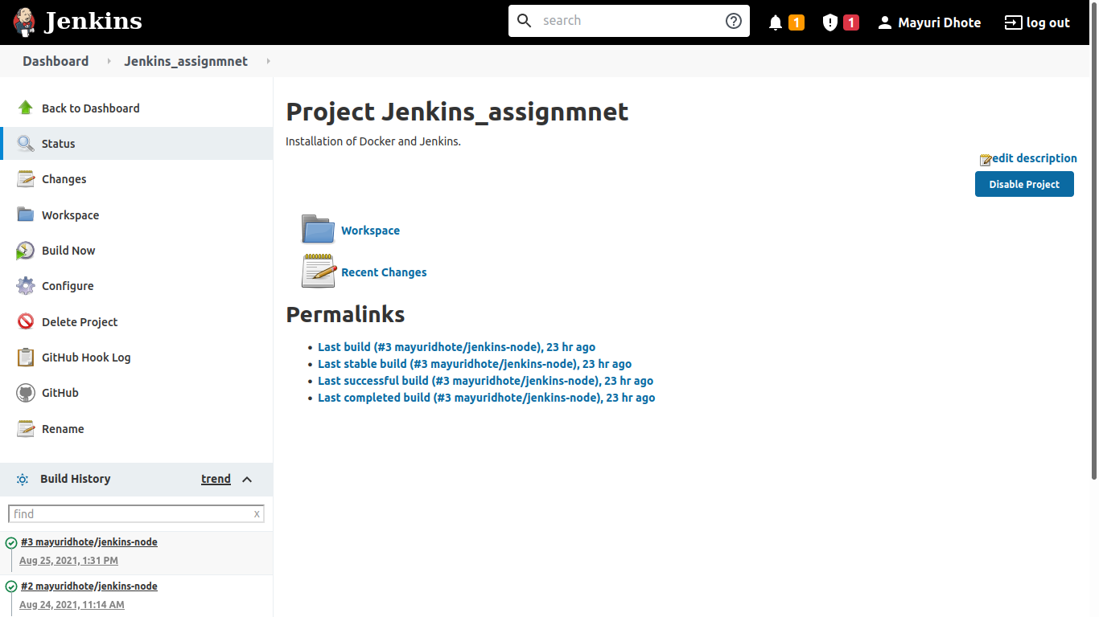
Required command to run the application and the ports being used are present in the Github repository. Configuring the Jenkins Pipeline

Slide 11
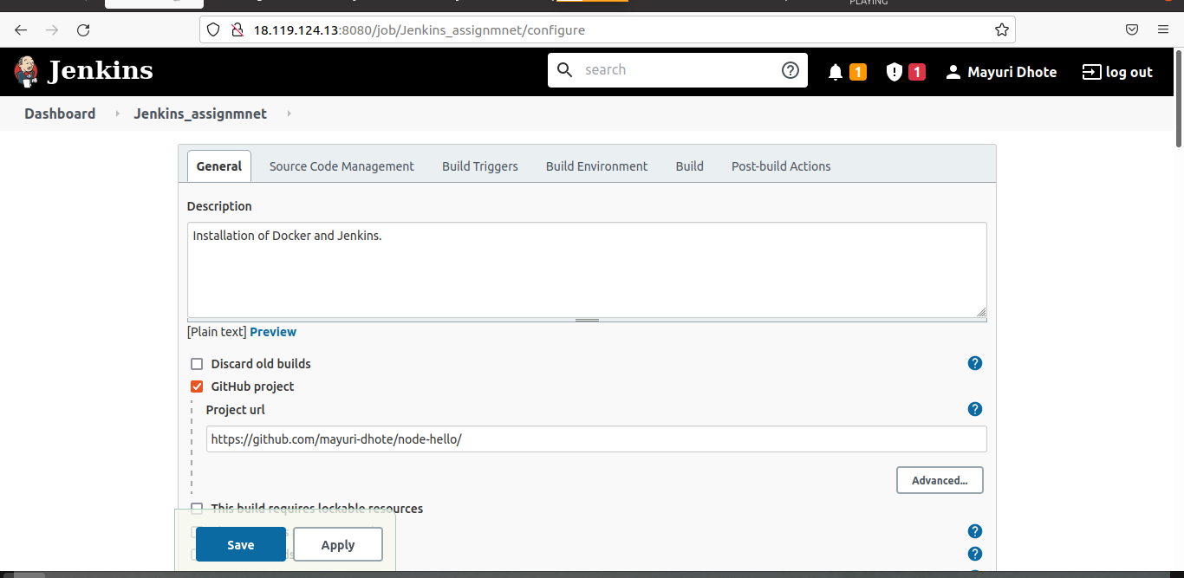
Required command to run the application and the ports being used are present in the Github repository. Configuring Steps Of Jenkins

Slide 12
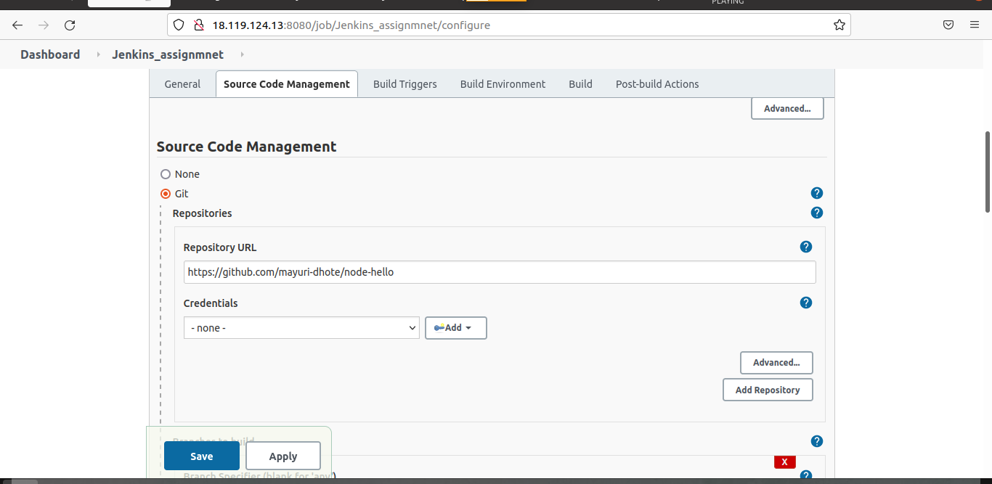
Required command to run the application and the ports being used are present in the Github repository. Configuring Steps Of Jenkins

Slide 13
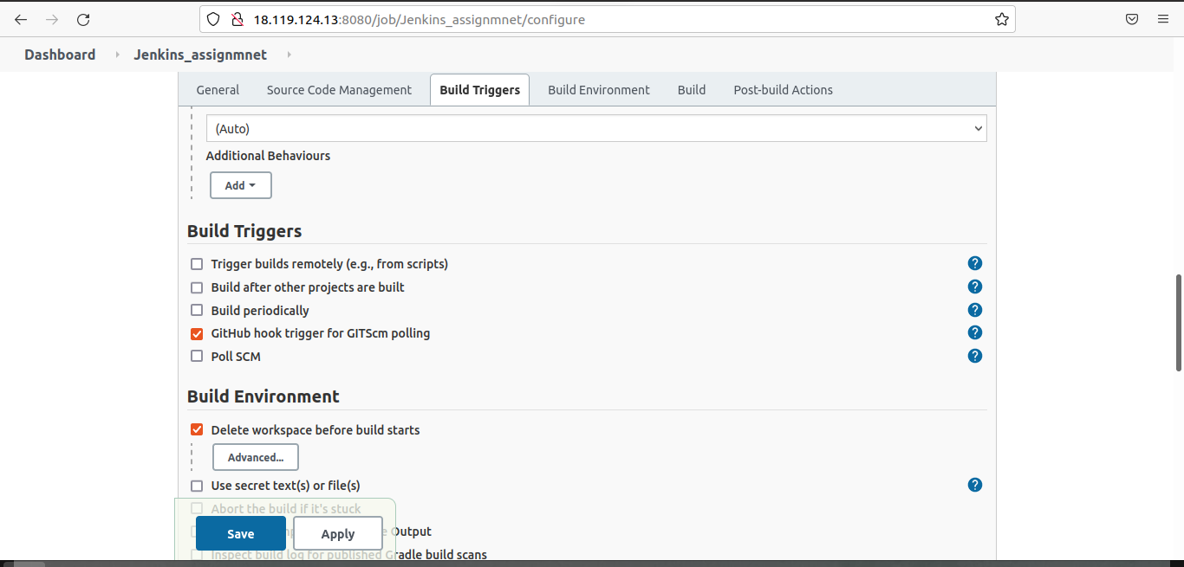
Required command to run the application and the ports being used are present in the Github repository. Configuring Steps Of Jenkins

Slide 14
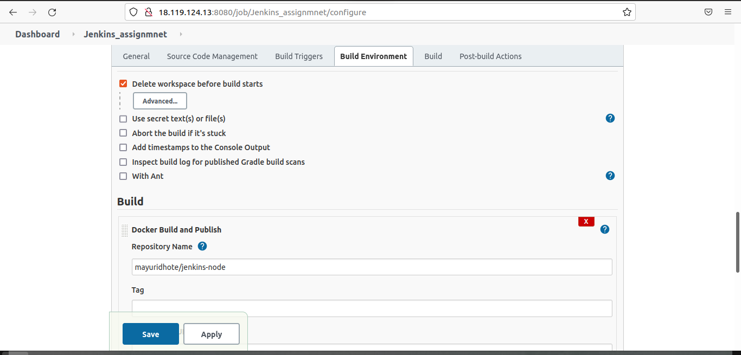
Required command to run the application and the ports being used are present in the Github repository. Configuring Steps Of Jenkins

Slide 15
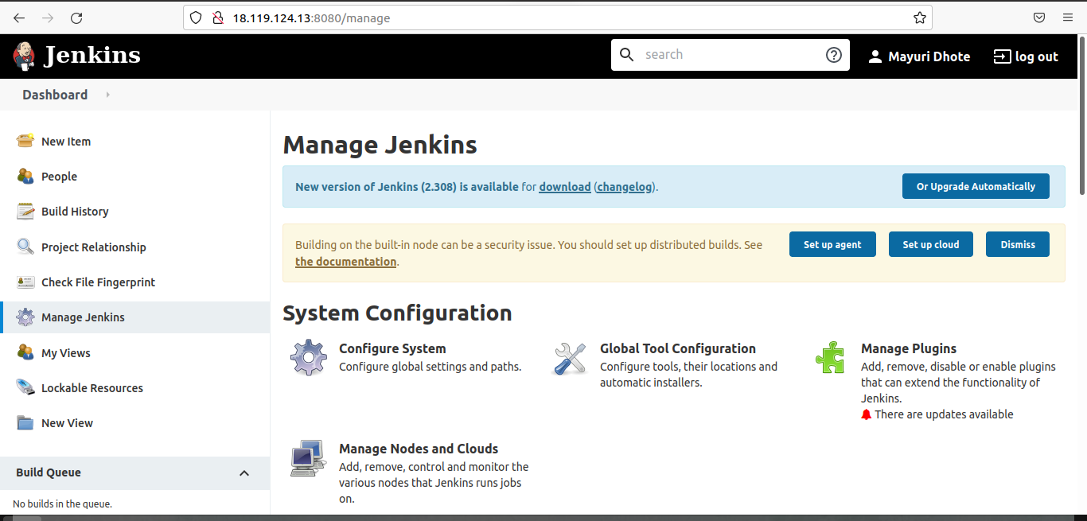
Required command to run the application and the ports being used are present in the Github repository. Installing Jenkins Plugins

Slide 16
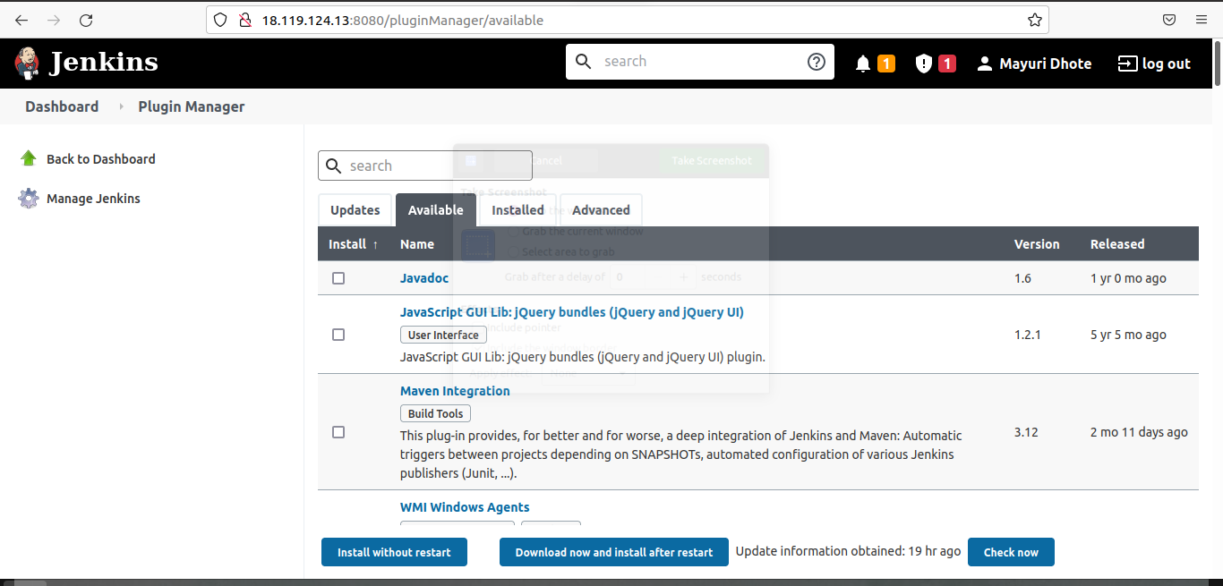
Required command to run the application and the ports being used are present in the Github repository. Installing Jenkins Plugins

Slide 17
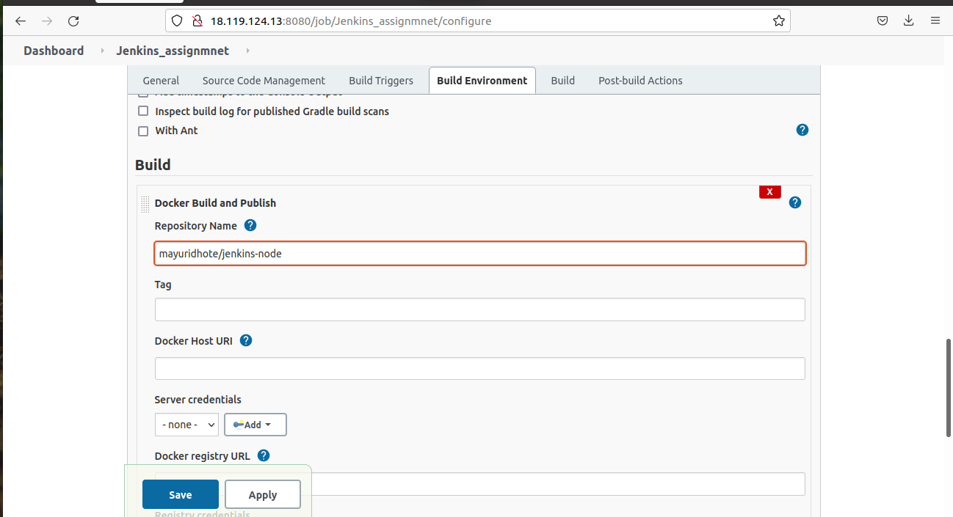
Required command to run the application and the ports being used are present in the Github repository. Adding NodeJs in the Jenkins Pipeline

Slide 18
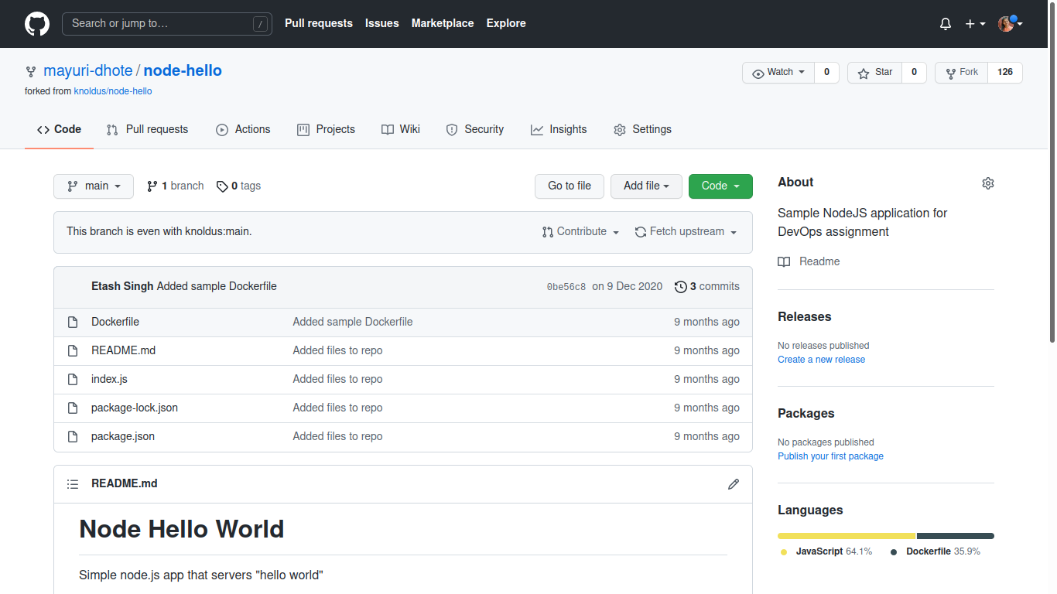
Required command to run the application and the ports being used are present in the Github repository. Github Repository

Slide 19
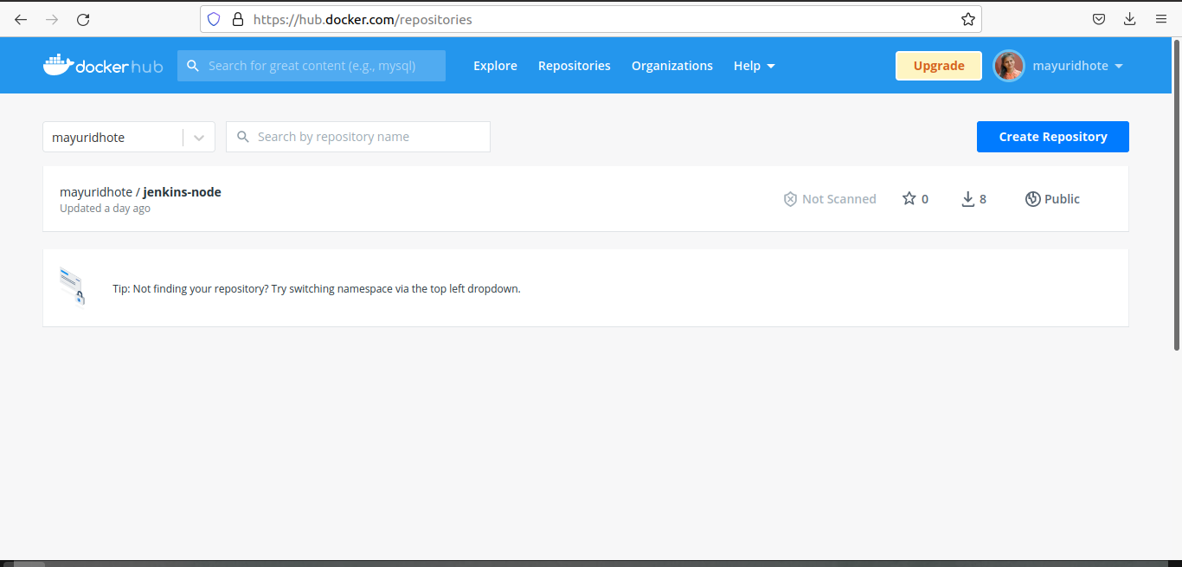
The application should be containerized and should be running on docker. Creating Account at Docker Hub & making a Container

Slide 20
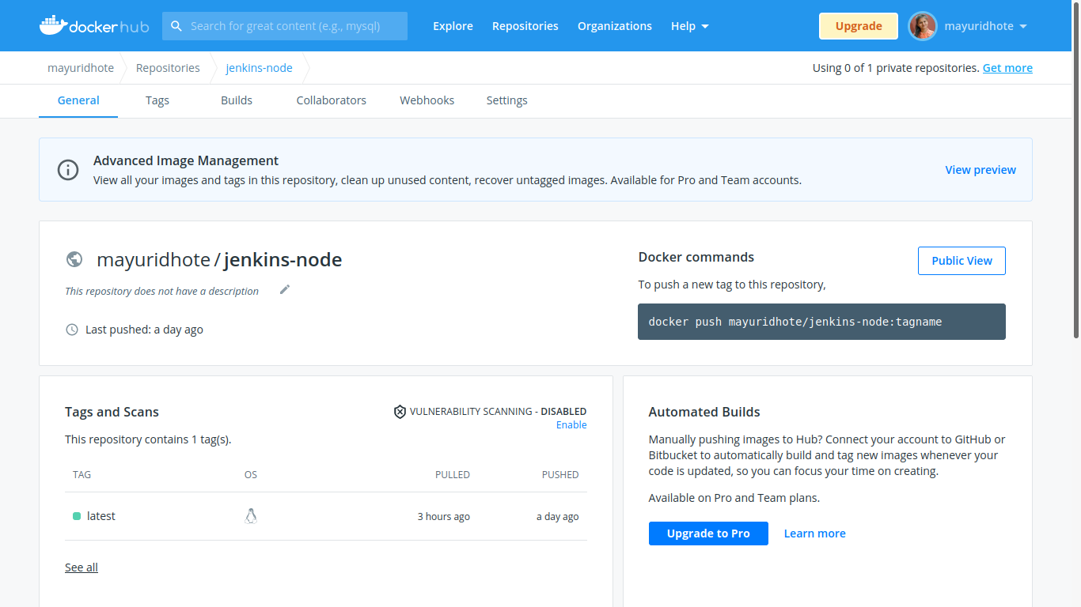
The application should be containerized and should be running on docker. Creating Account at Docker Hub & making a Container

Slide 21
Implement use of Global Tools Configuration to use Node JS effectively Implementing Global Tool Configuration in Jenkins

Slide 22
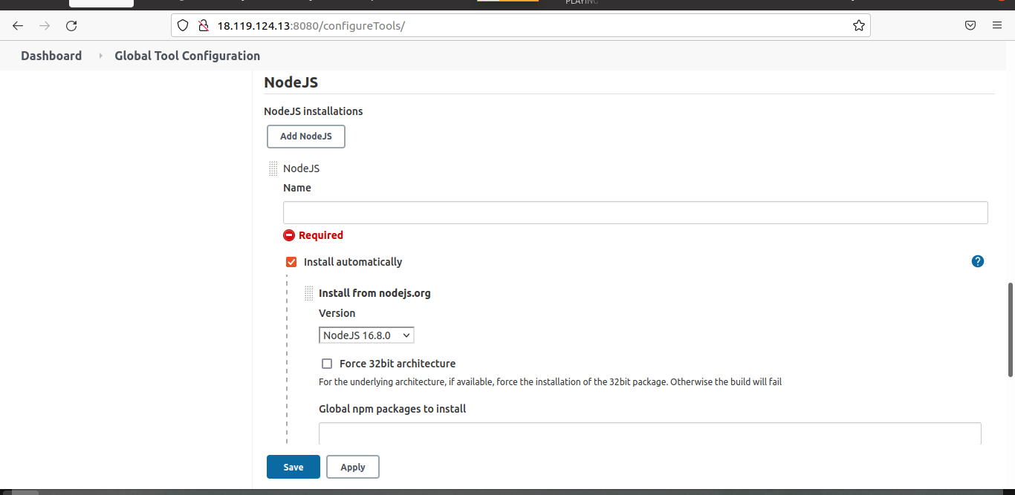
Implement use of Global Tools Configuration to use Node JS effectively Adding NodeJs Configuration

Slide 23
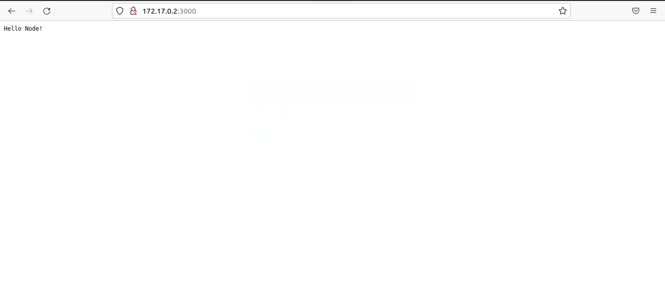
The validations can be performed by hitting endpoints: <VM_IP>:3000 or <VM_IP>:3001 Validation of <VM_IP>:3000 Port

Slide 24
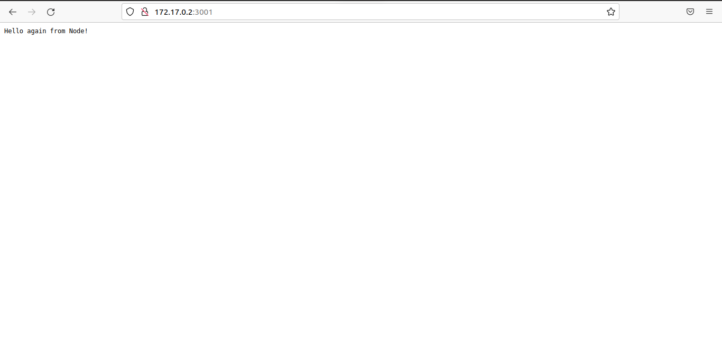
The validations can be performed by hitting endpoints: <VM_IP>:3000 or <VM_IP>:3001 Validation of <VM_IP>:3001 Port

Slide 25

Thank You!

